Slide 1


Faculty of Computing and Informatics
Business Management Information Systems –BMC511S
Lesson 4 – e-Commerce

Slide 2
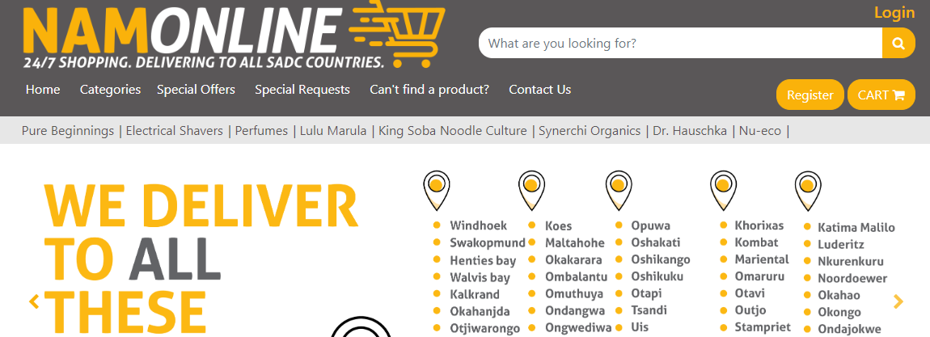
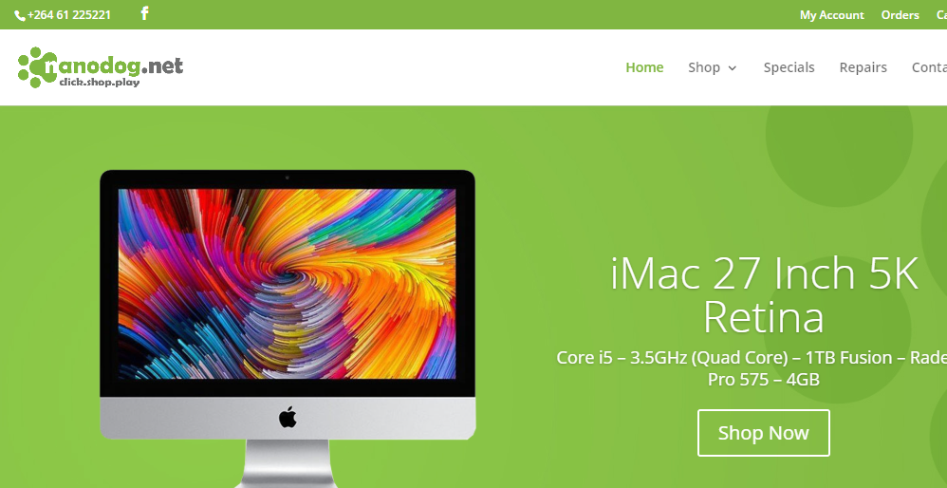
Faculty of Computing and Informatics
eCommerce
Definition of eCommerce
Unique features of eCommerce
Effects of the Internet on the marketplace
Benefits and downside of eCommerce
Major types of eCommerce
ECommerce Business models
Ecommerce Revenue Models
Electronic data Interchange
Net Marketplaces
Exchanges
M-Commerce

Slide 3
Uber Digitally Disrupts the Taxi Industry
Problem
  Opportunities presented by new technology
  Political and regulatory hurdles
Solutions
  Driver and rider apps
  Demand prediction software
Illustrates the use of I T to create new services as well as business models
Demonstrates the disruptive effects of new technologies

Slide 4
Faculty of Computing and Informatics
Definition of ecommerce
Ecommerce is defined as follows:
E-commerce refers to the use of the internet and the web to transact business.
More formally, e-commerce is about digitally enabled commercial transactions between and among organizations and individuals.
E-commerce is the buying and selling of goods and services or the transmission of funds or data over the internet
Ecommerce is business conducted through the use of computers, telephones, fax machines, barcode readers, credit cards, ATMs, etc. without an exchange of paper documents
Commercial transactions involve the exchange of value (e.g., money) across organizational or individual boundaries in return for products and services.

Slide 5
Faculty of Computing and Informatics
Unique features of internet and web as commercial media
The internet and web as commercial media have the following features:
Ubiquity - Marketspace is virtual, Transaction costs reduced
Global reach- Transactions cross cultural and national boundaries
Universal standards -One set of technology standards: Internet standards
Richness-Supports video, audio, and text messages

Slide 6
Faculty of Computing and Informatics
Unique features of internet and web as commercial media
UBIQUITY
Internet/Web technology available everywhere: work, home, and so on, anytime via desktop and mobile devices
Effect:
Marketplace removed from temporal, geographic locations to become “marketspace”
Enhanced customer convenience and reduced shopping costs
Reduces transaction costs
Costs of participating in market

Slide 7
Faculty of Computing and Informatics
Unique features of internet and web as commercial media
GLOBAL REACH
The technology reaches across national boundaries, around the earth
Effect:
Commerce enabled across cultural and national boundaries seamlessly and without modification.
Marketspace includes, potentially, billions of consumers and millions of businesses worldwide.

Slide 8
Faculty of Computing and Informatics
Unique features of internet and web as commercial media
UNIVERSAL STANDARDS
One set of technology standards namely internet standards
Effect:
Disparate computer systems easily communicate with one another
Lower market entry costs—costs merchants must pay to bring goods to market
Lower consumers’ search costs—effort required to find suitable products

Slide 9
Faculty of Computing and Informatics
Unique features of internet and web as commercial media
RICHNESS
Complexity and content of a message, e.g. supports video, audio, and text messages
Effect:
Possible to deliver rich messages with text, audio, and video simultaneously to large numbers of people.
Video, audio, and text marketing messages can be integrated into single marketing message and consumer experience.

Slide 10
Faculty of Computing and Informatics
Unique features of internet and web as commercial media
INTERACTIVITY
The technology works through interaction with the user.
Effect:
Consumers engaged in dialog that dynamically adjusts experience to the individual.
Consumer becomes co-participant in process of delivering goods to market.

Slide 11
Faculty of Computing and Informatics
Unique features of internet and web as commercial media
PERSONALISATION / CUSTOMISATION
Technology permits personalised messages to be delivered to individuals and groups and modification of messages and goods
Effect:
Personalized messages can be sent to individuals as well as groups.
Products and services can be customized to individual preferences.

Slide 12
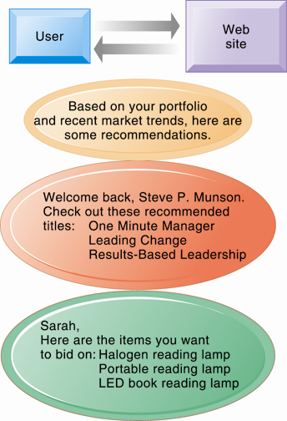
Web Site Personalization

Slide 13
Faculty of Computing and Informatics
Unique features of internet and web as commercial media
SOCIAL TECHNOLOGY
The technology promotes user content generation and social networking
Effect:
New Internet social and business models enable user content creation and distribution, support social networks
Many-to-many model

Slide 14
Faculty of Computing and Informatics
Effects of the internet on the marketplace:
Reduces information asymmetry – When one party in a transaction has more information than the other they have higher bargaining power
Offers greater flexibility and efficiency because of:
Reduced search costs and transaction costs
Lower menu costs – merchants’ costs of changing prices
Greater price discrimination
Dynamic pricing – the price of product varies depending on the demand characteristics of the customer or the supply situation of the seller

Slide 15
Faculty of Computing and Informatics
Effects of the internet on the marketplace:
Offers greater flexibility and efficiency because of:
May reduce or increase switching costs
May delay gratification: immediate consumption of goods possible with digital goods and yet with physical goods a product has to be transported
Increased market segmentation
Stronger network effects
More disintermediation – bypassing intermediaries such as distributors or retail outlets in the distribution channel

Slide 16
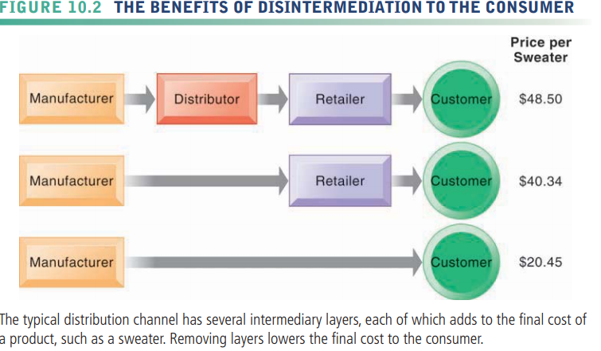

Slide 17
Faculty of Computing and Informatics
Benefits of eCommerce
Its round-the-clock availability
The enhanced speed of access
The wide availability of goods and services for the consumer
Easy accessibility
No brick and mortar shop to sell from
International reach

Slide 18
Faculty of Computing and Informatics
Downside of eCommerce
Sometimes limited customer service
Consumers not being able to see or touch a product prior to purchase
Waiting time for product shipping
Security and privacy issues

Slide 19
Faculty of Computing and Informatics
Ecommerce technologies and applications
The technologies include:
Mobile commerce (mCommerce)
Electronic funds transfer
Supply chain management
Internet marketing
Online transaction processing
Electronic Data Interchange (EDI)
Inventory management systems
Automated data collection systems
The applications include:
Email, online catalogs and shopping carts, web services, file transfer protocol,etc

Slide 20
Faculty of Computing and Informatics
Major types of e-commerce
Business-to-consumer (B2C) –products and services to individual shoppers
  Example: www.nanodog.net which electronics, software and computer accesories
Business-to-business (B2B)
  Example: ChemConnect selling chemicals and plastics
Consumer-to-consumer (C2C)
  Example: http://classifieds.com.na/ where people sell their goods to other consumers
E-commerce can be categorized by platform
  Mobile commerce (m-commerce)

Slide 21
Faculty of Computing and Informatics
E-commerce business models
Portal – a gateway to the web or site which users set as their home pages
E-tailer – online retail stores that sell physical products directly to consumers or to individual businesses
Content provider – Creates revenue by providing digital content such as music, videos, news, over the web
Transaction broker – saves users money and time by processing online sales transactions and generating a fee each time a transaction occurs
Market creator – provides a digital environment where buyers and sellers can meet
Service provider – provides web 2.0 applications such as photo sharing, video sharing and user-generated content
Community provider – provides an online meeting place where people with similar interests can communicate and find useful information

Slide 22
Faculty of Computing and Informatics
E-commerce revenue models
Advertising revenue model – a website generates a revenue by attracting a large audience of visitors who are then exposed to advertisements
Sales revenue model – companies derive revenue by selling goods, information and services to customers
Subscription revenue model – a web site offering content or services charges a subscription fee for access to some or all of its offerings on an ongoing basis
Free/Freemium revenue model – firms offer basic services or content for free, while charging a premium for advanced or special features
Transaction fee revenue model – a company receives a fee for enabling or executing a transaction
Affiliate revenue model – websites that send visitors to other websites in return for a referral feee

Slide 23
Faculty of Computing and Informatics
Electronic data interchange (EDI)
Business-to-business ecommerce refers to commercial transactions that occur among business firms
Computer-to-computer exchange of standard transactions such as invoices, purchase orders, shipment orders, etc.
Major industries have EDI standards that define structure and information fields of electronic documents.
More companies are increasingly moving toward private networks that allow them to link to a wider variety of firms than EDI allows and share a wider range of information in a single system.

Slide 24
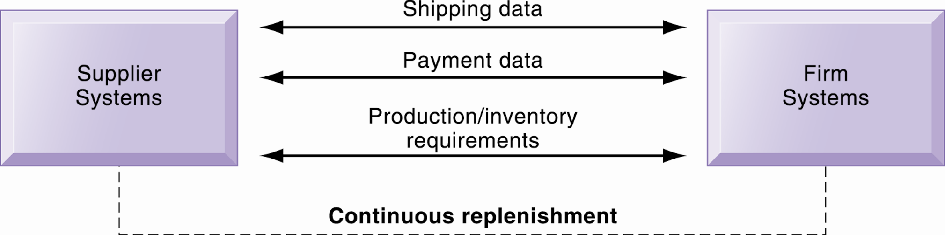
Electronic Data Interchange

Slide 25
Faculty of Computing and Informatics
Private industrial network (private exchange)
Large firms using a secure web site (extranet) to link to its suppliers, distributors, and other key business partners
The network is owned by buyer
The network permits the sharing of:
Product design and development
Marketing
Production scheduling and inventory management
Unstructured communication (graphics and e-mail)

Slide 26
Faculty of Computing and Informatics
Net marketplaces (e-hubs)
Net market places are:
Single market based on internet technology for many buyers and sellers
Industry-owned or owned by independent intermediary
Generate revenue from transaction fees, other services
Use prices established through negotiation, auction, RFQs, or fixed prices
May focus on direct goods (goods used in the production process, (e.g. sole for shoe production) or indirect goods (e.g. products for maintenance and repair)
May be vertical (for specific industries such as telecoms, automobiles) or horizontal marketplaces (for goods and services found in many industries, e.g. office equipment)

Slide 27
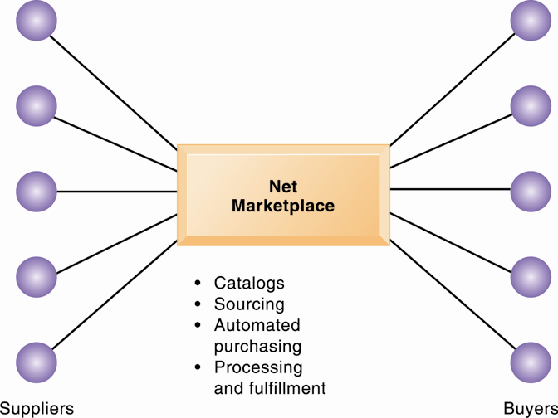

Slide 28
Faculty of Computing and Informatics
Exchanges
Exchanges are:
Independently owned third-party Net marketplaces
Connect thousands of suppliers and buyers for spot purchasing
Typically provide vertical markets for direct goods for single industry (food, electronics)
Proliferated during early years of e-commerce; many have failed
Competitive bidding drove prices down and did not offer long-term relationships with buyers or services to make lowering prices worthwhile.

Slide 29
Faculty of Computing and Informatics
M-commerce definition
The buying and selling of goods and services through wireless handheld devices such as cellular telephone and personal digital assistants
Fastest growing form of e-commerce -some areas growing at 50 percent or more
Location-based services such as geo-social services, geo-advertising, geo-information services
Geo-social services – where friends meet
Geo-advertising – where you can find the nearest business, e.g. restaurant, park
Geo-information – that can provide information about different ventures
Main areas of growth (exclusive of location-based services)
  Retail sales at top Mobile 400 (Amazon, eBay, etc.)
  Sales of digital content (music, TV, etc.)

